Slide 1
European Soccer Bets
Leonardo Perrone
Senior, Computer Engineering

Slide 2
The Dataset
+25,000 matches
+10,000 players
11 European Countries with their lead championship
Seasons 2008 to 2016
Players and Teams' attributes* sourced from EA Sports' FIFA video game series, including the weekly updates
Team line up with squad formation (X, Y coordinates)
Betting odds from up to 10 providers
Detailed match events (goal types, possession, corner, cross, fouls, cards etc...) for +10,000 matches

Slide 3
The Dataset (cont.)
7 Tables:
"Country"
"League"
"Match"
"Player"
"Player_Attributes"
"Team"
"Team_Attributes"

Slide 4
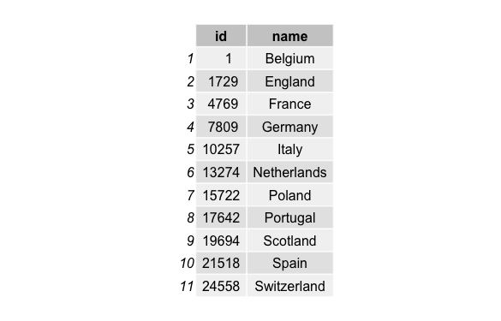
Country Table

Slide 5
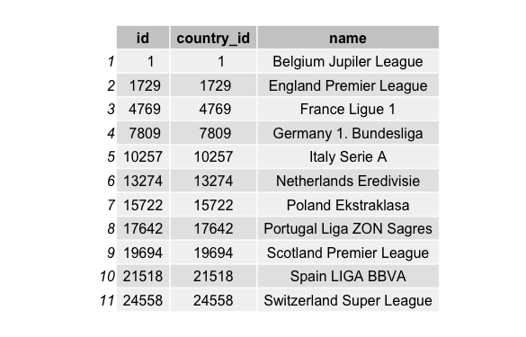
League Table

Slide 6
Match Table
Countries
Leagues
Seasons
Dates
Players that played each game
Home team goals
Away team goals
Shot on/off target
Foul committed
Card
Corner
Crosses
...

Slide 7
Player Table
Player Name
Birthday
Height
Weight

Slide 8
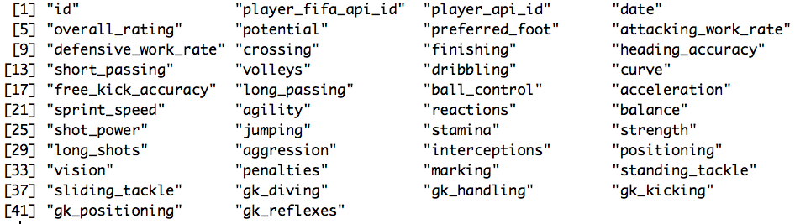
Player Attributes Table

Slide 9
Team Table
Team Name
Team Short Name

Slide 10
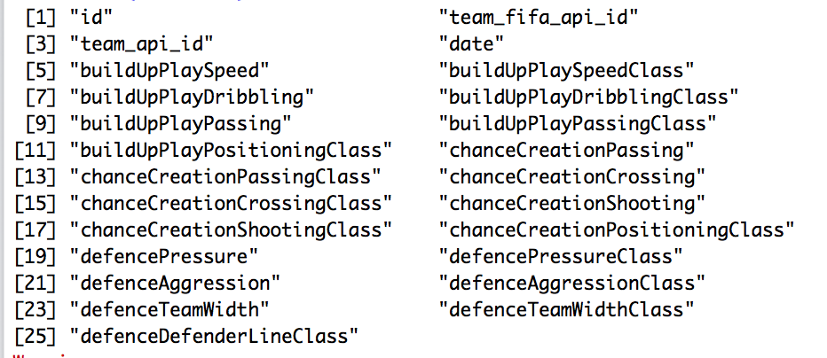
Team Attributes Table

Slide 11
Objective
Can we predict if the home team will win, if the odds are in its favor?

Slide 12
Analysis
Binary classification using LDA, QDA and KNN.
Simple and efficient.

Slide 13
Attributes
What are the attributes that can be use for this analysis?
"buildUpPlaySpeedClass”
"buildUpPlayDribblingClass”
"buildUpPlayPassingClass”
"buildUpPlayPositioningClass"
"chanceCreationPassingClass"
"chanceCreationCrossingClass"
"chanceCreationShootingClass"
"chanceCreationPositioningClass"
"defencePressureClass"
"defenceAggressionClass”
"defenceTeamWidthClass"
"defenceDefenderLineClass"
"B365H"
"B365D"
"B365A"
Merged Match Table with Team Attributes Tables

Slide 14
Labels
Classification Labels
Bet or do not bet? If these are true: Home team wins the game Home team was favorited by odds Then Bet is 1, else is 0

Slide 15
The Final Matrix
The final matrix
"buildUpPlaySpeedClass”
"buildUpPlayDribblingClass”
"buildUpPlayPassingClass”
"buildUpPlayPositioningClass"
"chanceCreationPassingClass"
"chanceCreationCrossingClass"
"chanceCreationShootingClass"
"chanceCreationPositioningClass"
"defencePressureClass"
"defenceAggressionClass”
"defenceTeamWidthClass"
"defenceDefenderLineClass"
"B365H"
"B365D"
"B365A”
”Bet”

Slide 16
Data Splitting
Divide the dataset
Training
60%
Testing
30%
Validation
10%

Slide 17
Linear Discriminant Analysis
Maximizes the component axes for class-separation.
Used to predict a categorical dependent variable by one or more continuous or binary independent variables

Slide 18
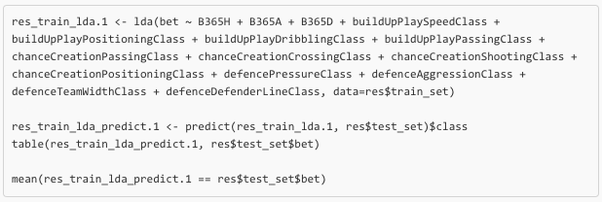
Linear Discriminant Analysis (cont.)
The analysis:

Slide 19
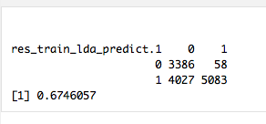
Linear Discriminant Analysis (cont.)
Results:

Slide 20
Quadratic Discriminant Analysis
Quadratic discriminant analysis uses a different covariance matrix for each class.
Used often if there is a small number of variables.

Slide 21
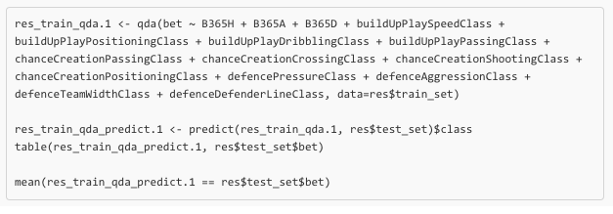
Quadratic Discriminant Analysis (cont.)
The analysis:

Slide 22
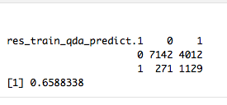
Quadratic Discriminant Analysis (cont.)
Results:

Slide 23
K-nearest Neighbor Analysis
Depends on k value and Euclidian distance between points (in our case).
Very simple implementation.

Slide 24
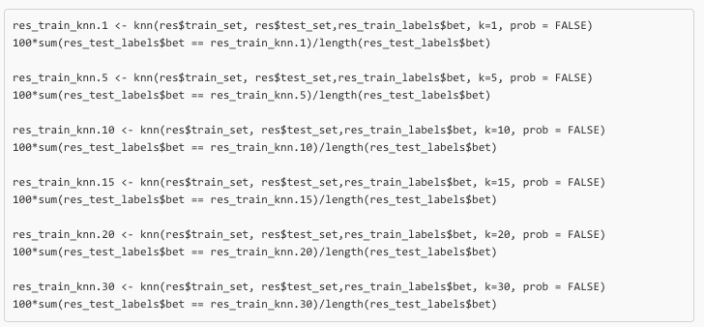
K-nearest Neighbor Analysis (cont.)
The analysis:

Slide 25
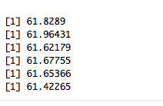
K-nearest Neighbor Analysis (cont.)
Results:
K=1
K=5
K=10
K=15
K=20
K=30

Slide 26
Summary of Training
Comparison:
LDA
67.46%
QDA
65.88%
KNN
61.96%

Slide 27
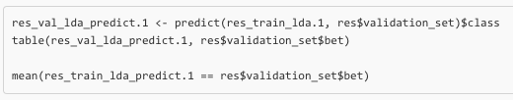
Validation

Slide 28
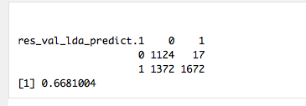
Validation (cont.)
Results:

Slide 29
Conclusion
LDA generalization error was low.
Accuracy is better than I expected, but in general poor.
More diversified attributes are needed to improve prediction accuracy.

Slide 30
Thank you!
Questions?

